Slide 1
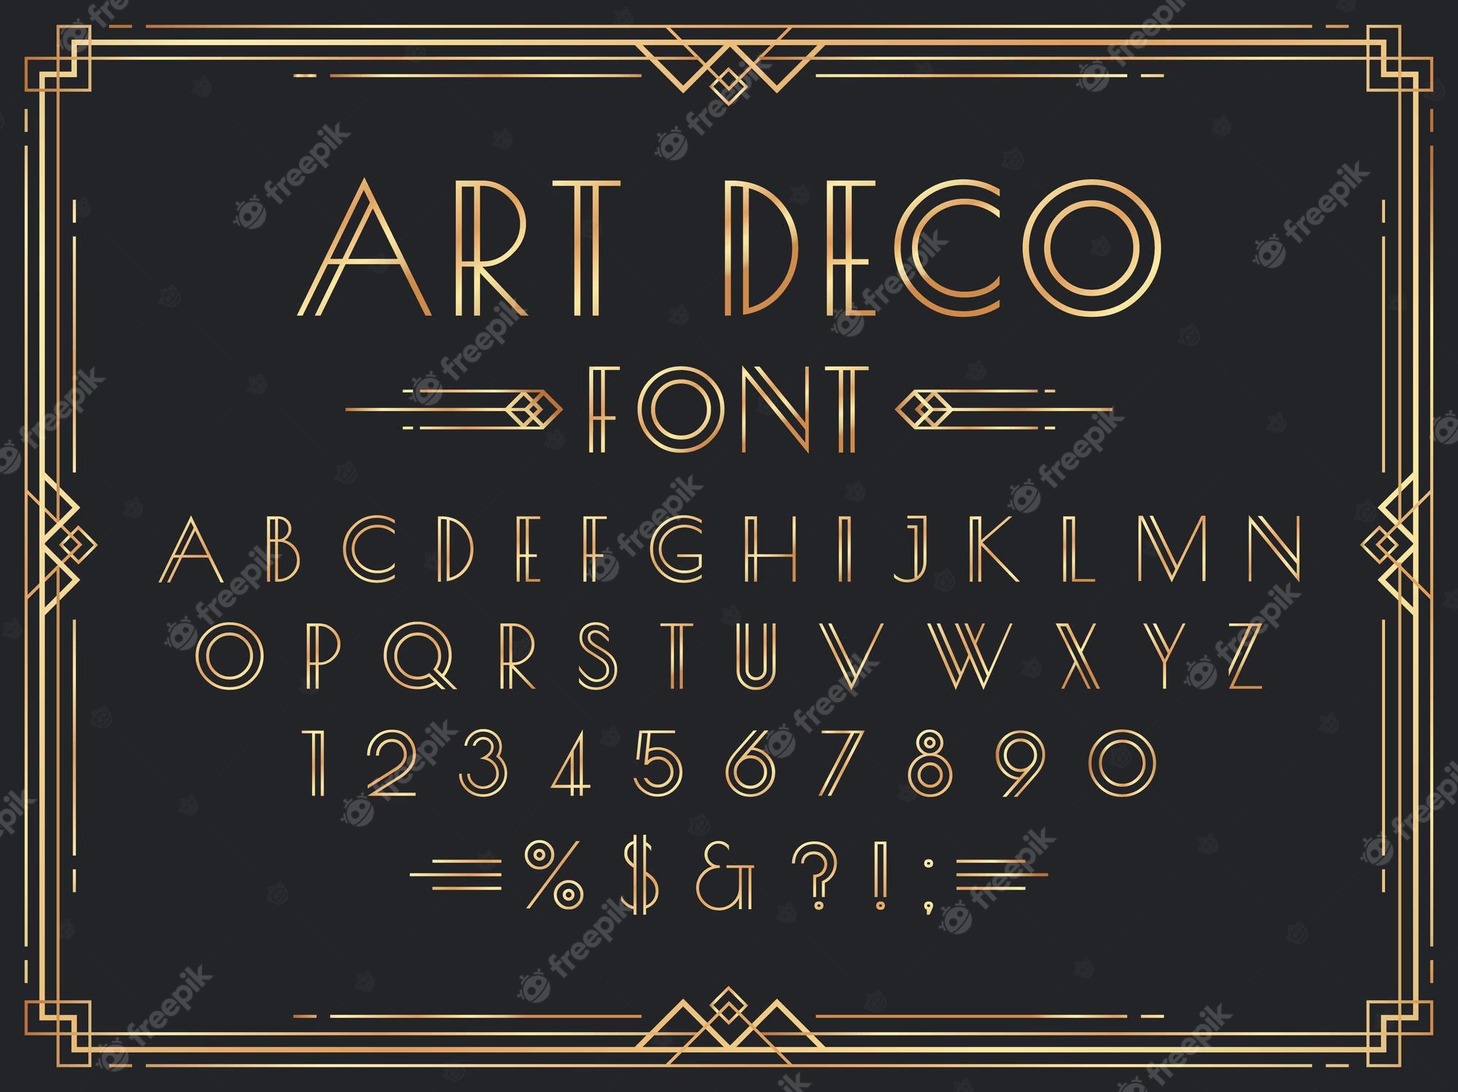

Slide 2

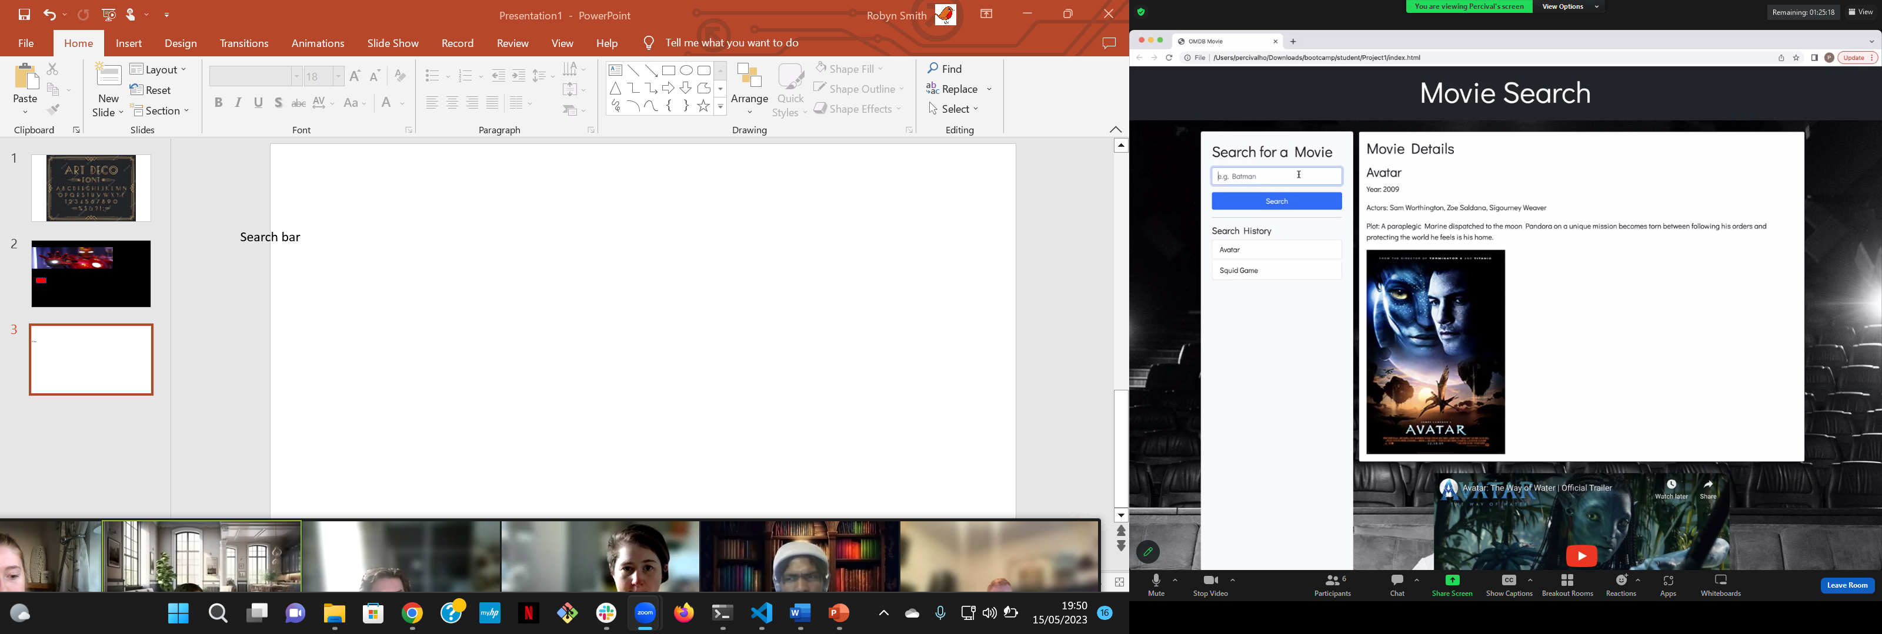
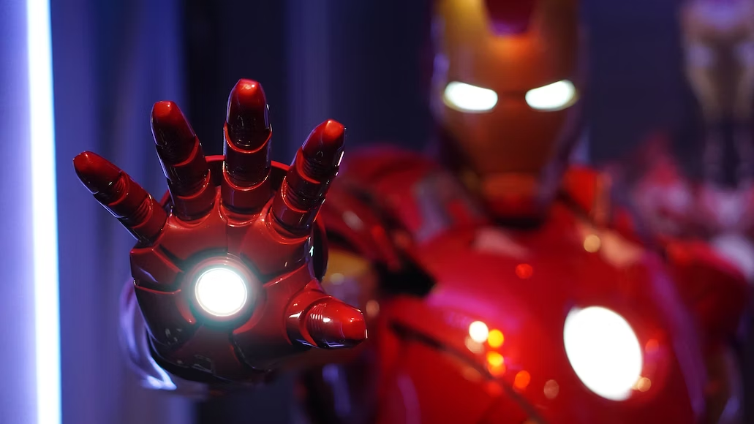

Random generator
Watch list

Slide 3
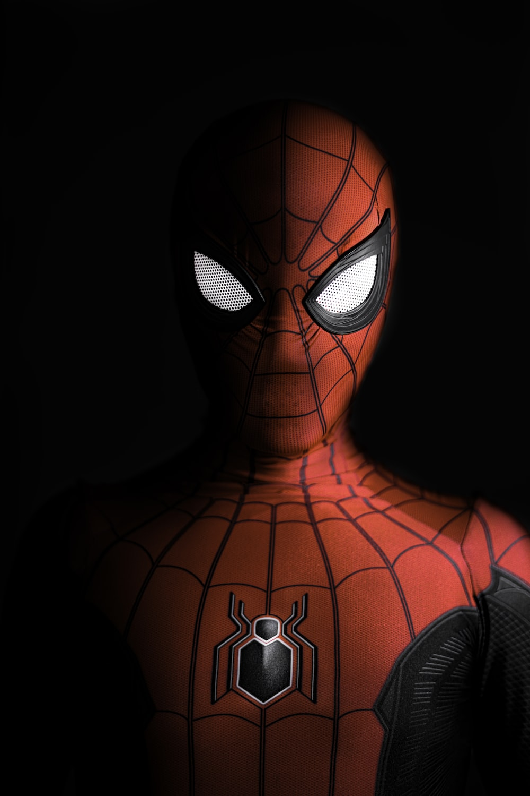
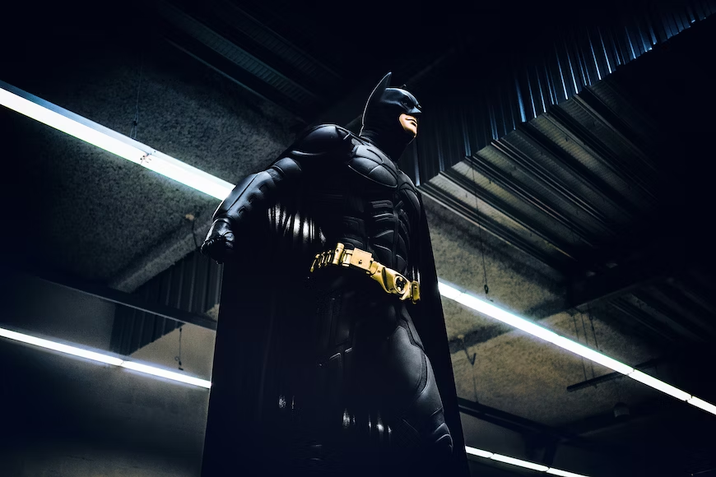



Border created in CSS
https://stackoverflow.com/questions/65758024/art-deco-style-border-in-css
Google font – art deco style-font family:
broadway
Welcome page design 1
Picturesque
Button link to view watch list html
Nav bar
Random film
Watch list
Google font-
Font family:
Imprint MT Shadow
Search for a movie
Search bar
Search button
Images of popular films that link directly to the info page
Search history
Avatar
Fall

Slide 4
Picturesque
Elaborate design 2 of webpage
Lights going round the light box or flashing
Random film
Search for a movie
Watch list
Search bar
Search button
Search history
Avatar
Lion king

Slide 5
Nav bar and buttons to other htmls
Main.html
Watch list
Random film
Header containing brand name with art deco styling
Link to trailer & modal via clicking poster image
Search bar moves to the aside
Main content- picture name of film info
Background image cinema? Or just black

Slide 6
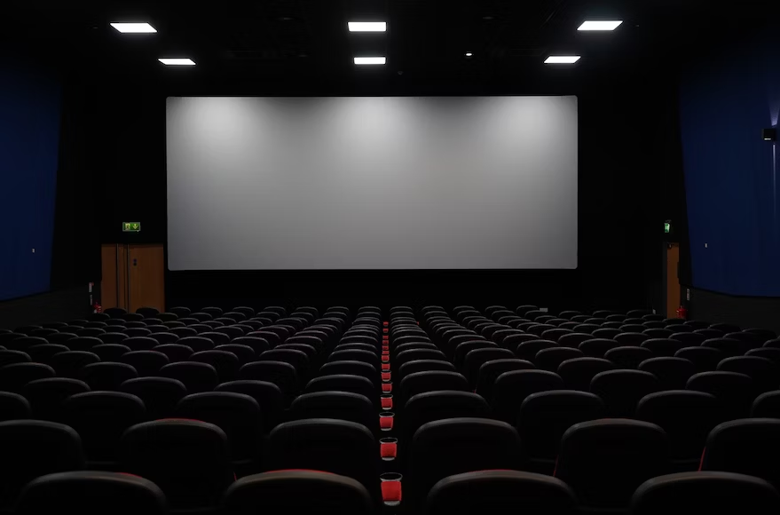
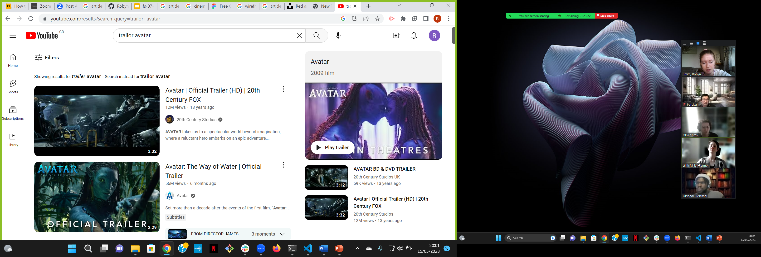
This is a modal

Slide 7


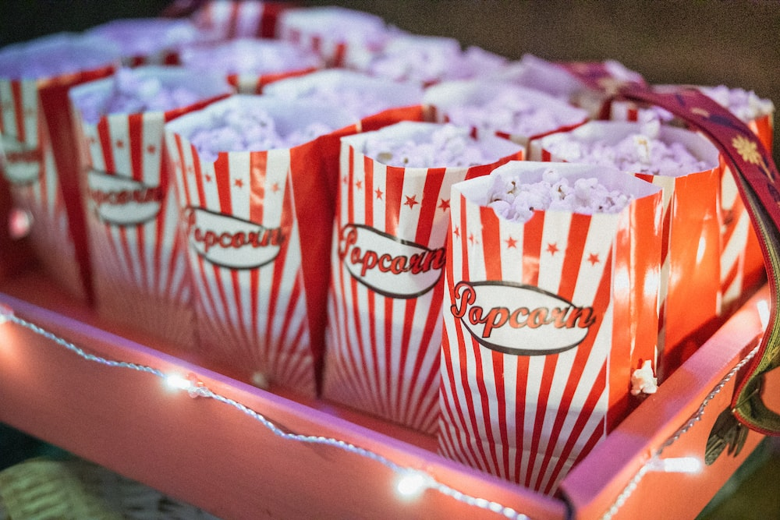
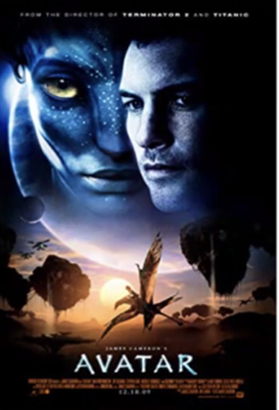
Picturesque
poster | Name of film
Random film
Watch list

Slide 8



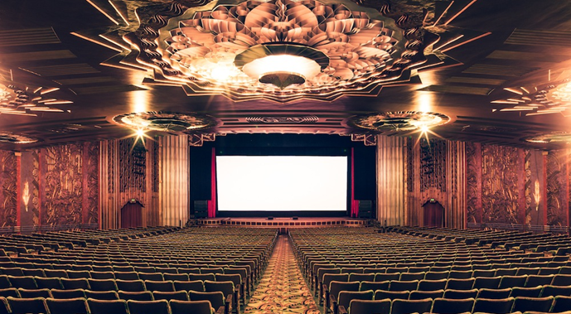
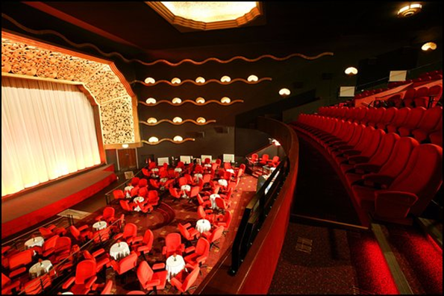
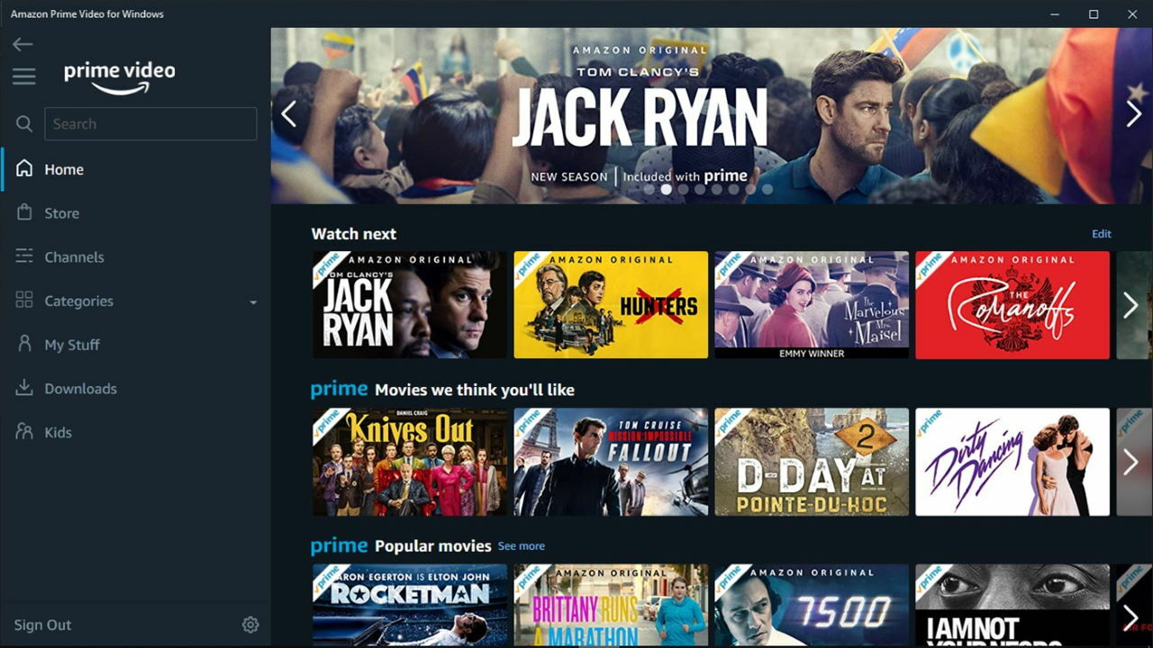
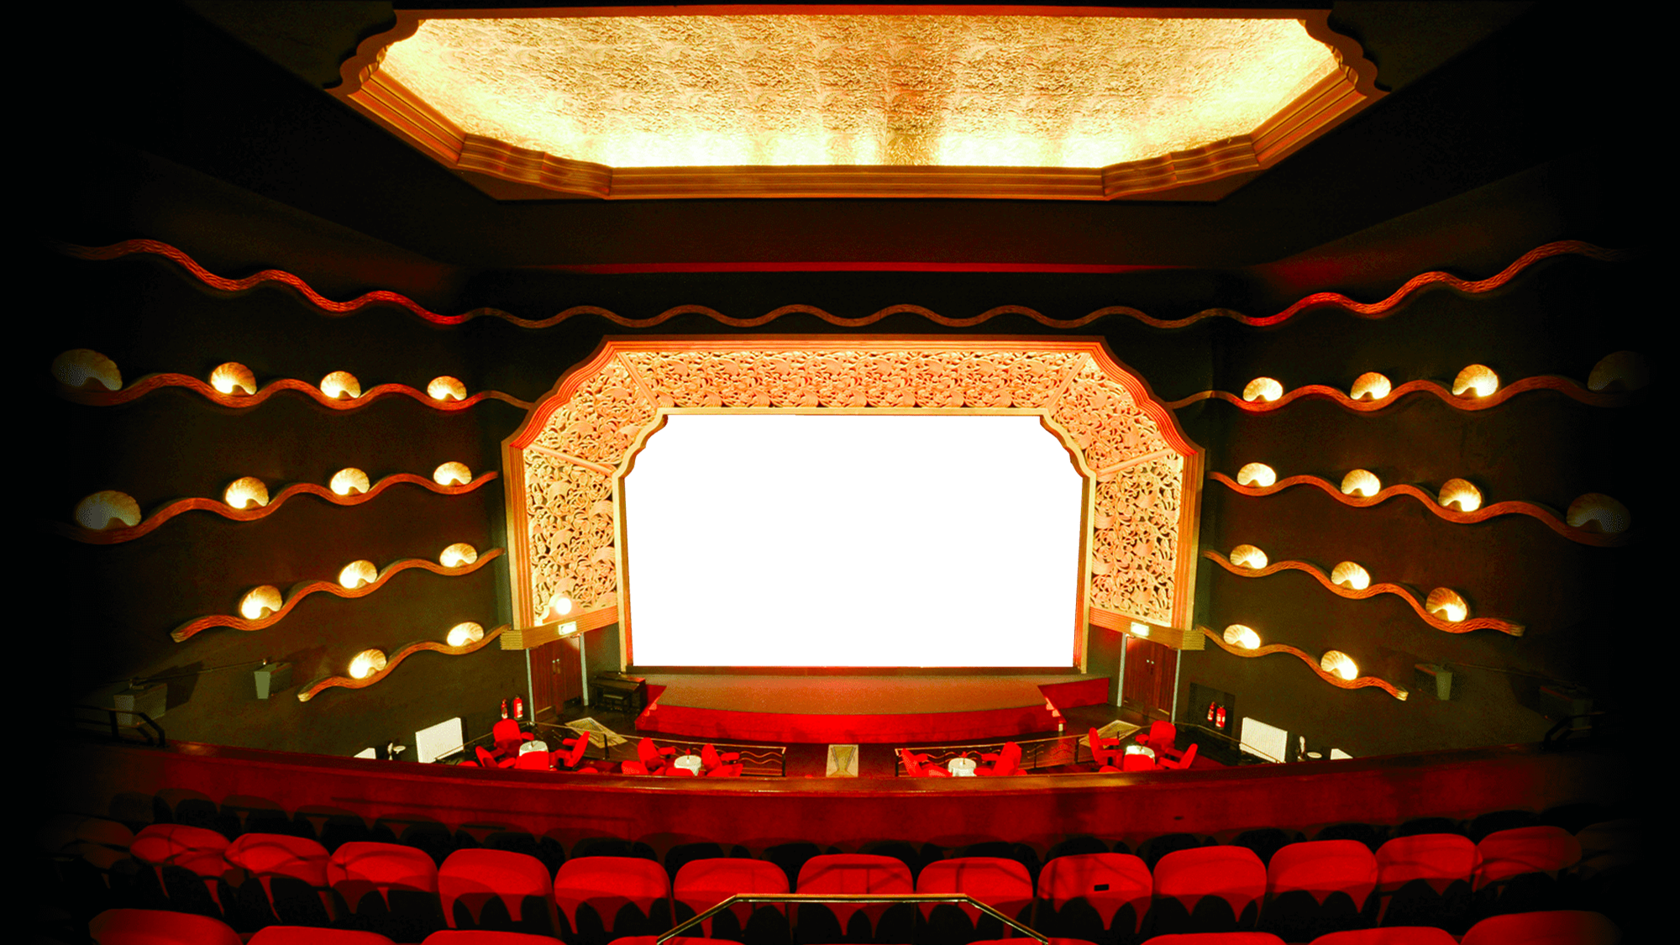
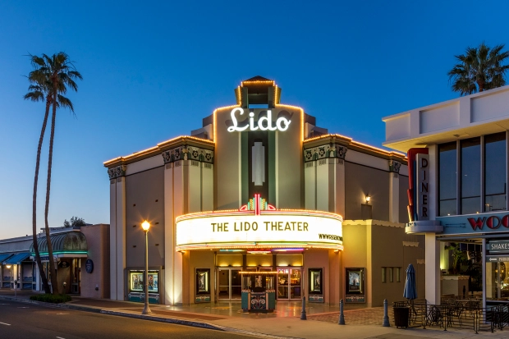
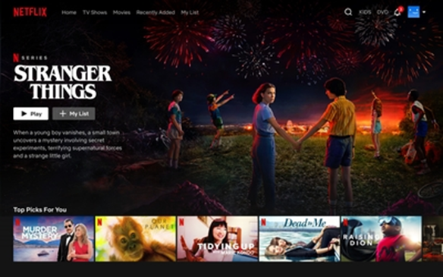
Inspiration:

